Slide 1

Problems on Conditional Expectation 2014

Slide 2
Reference
Data
Youtube
Code

Slide 3
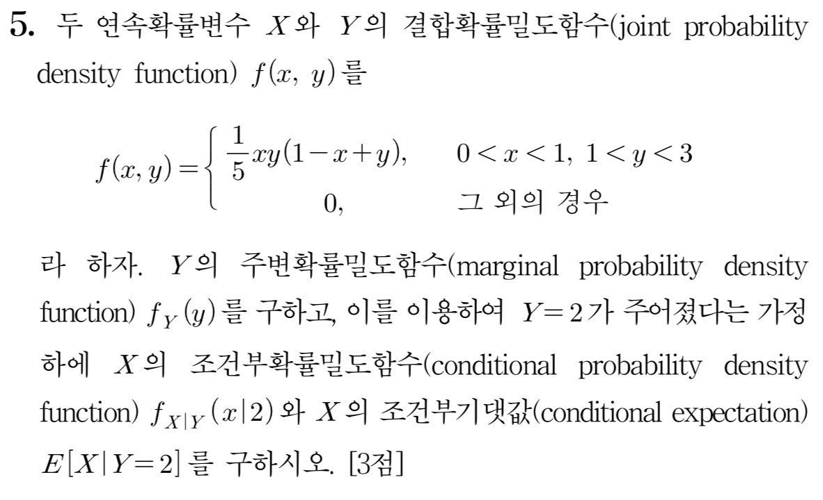
[2014]

Slide 4


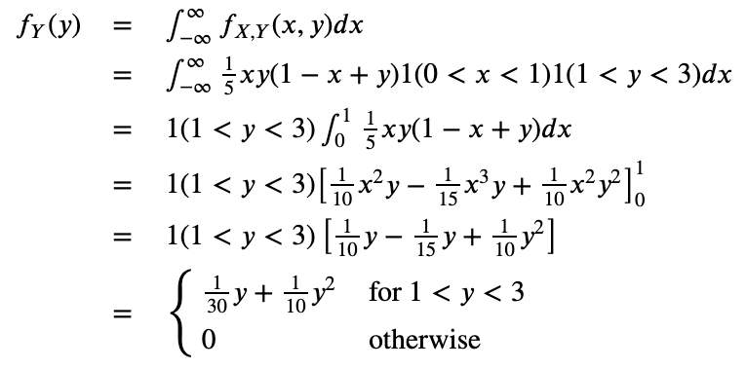

Slide 11
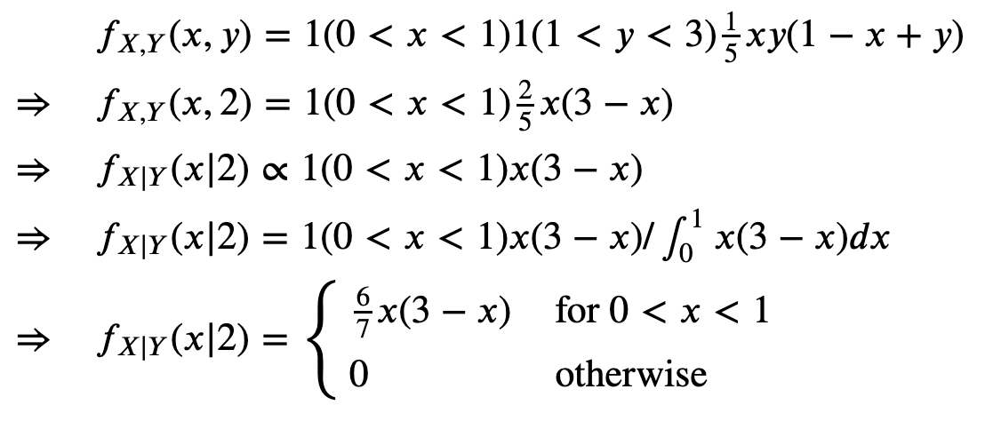

Slide 17

